Slide 1



Assignment 6: Multivariate Time series forecasting
ISM6561 Deep Learning
Team: Guardians of the galaxy

Slide 2
Project Objectives
Develop an LSTM-based forecasting model to predict household power consumption at the next time step using historical multivariate time series data.
Leverage a real-world energy dataset from the UCI Machine Learning Repository, containing minute-level electric power consumption measurements.
Apply comprehensive preprocessing techniques including resampling, normalization, and windowing to prepare the data for sequential modeling.
Optimize model performance through hyperparameter tuning using Weights & Biases (W&B) sweeps and Bayesian Optimization.
Evaluate model accuracy and reliability using metrics such as Mean Squared Error (MSE), Mean Absolute Error (MAE), and R² score.
Notes:
Script:
In this project, our primary objective was to develop a multivariate time series forecasting model to predict household power consumption at the next time step. To achieve this, we focused on several key goals.
Model Development:
We aimed to build and implement a Long Short-Term Memory (LSTM) model, known for its effectiveness in capturing temporal dependencies in sequential data.
Real-World Dataset:
To ensure the model was applicable to real-world scenarios, we used the Individual Household Electric Power Consumption Dataset, which contains over four years of detailed minute-level energy measurements.
Data Preprocessing:
We applied several preprocessing steps, including resampling, normalization, and windowing, to structure the data for time series forecasting.
Hyperparameter Optimization:
We conducted extensive hyperparameter tuning using Weights & Biases (W&B) sweeps and Bayesian Optimization to identify the most effective model configurations.
Model Evaluation:
Finally, we assessed the model's accuracy and reliability using key performance metrics such as Mean Squared Error (MSE), Mean Absolute Error (MAE), and R² score.
These objectives guided our approach in building a robust and accurate forecasting model capable of capturing complex energy consumption patterns.

Slide 3
Dataset and Preprocessing Pipeline
Dataset:
Individual Household Electric Power Consumption Dataset from the UCI Machine Learning Repository, containing over four years of minute-level measurements. Key features include Global_active_power, Voltage, Global_intensity, and multiple Sub_metering values.
Preprocessing Steps:
Missing Values: Handled with forward-fill and back-fill techniques to maintain continuity.
Resampling: Data resampled from 1-minute to 5-minute intervals to reduce noise and computational complexity.
Feature Scaling: Features normalized using Min-Max scaling to the range [0, 1] for better network performance.
Sequence Windowing: Employed a sliding window approach to create input-output pairs using 12 past time steps for modeling.
Train-Test Split: The dataset was split chronologically into 80% training and 20% testing subsets to ensure model evaluation on unseen data.
Notes:
Script:
We used a real-world energy dataset and applied a systematic preprocessing pipeline to prepare it for time series forecasting.
Dataset:
We utilized the Individual Household Electric Power Consumption Dataset from the UCI Machine Learning Repository. This dataset contains over four years of minute-level energy measurements, making it ideal for time series modeling.
Key features include Global_active_power, which represents the total power consumption, Voltage, measuring the average supplied voltage, Global_intensity, indicating the current intensity, and multiple Sub_metering values representing energy usage in different household zones.
Preprocessing Steps:
Missing Values:
To maintain temporal continuity, we handled missing values using a combination of forward-fill and back-fill techniques. This ensured that gaps were filled with the most recent or next available valid observation.
Resampling:
We resampled the data from 1-minute to 5-minute intervals. This reduced noise, smoothed short-term fluctuations, and decreased computational complexity without sacrificing meaningful trends.
Feature Scaling:
All features were normalized using Min-Max scaling to the range [0, 1]. This step improved model convergence and prevented features with larger ranges from dominating the learning process.
Sequence Windowing:
To capture temporal dependencies, we applied a sliding window approach, creating input-output pairs using 12 past time steps—equivalent to one hour of data—to predict the next time step’s power consumption.
Train-Test Split:
Finally, we split the dataset chronologically into 80% for training and 20% for testing. This ensured the model was evaluated on unseen future data, preserving the sequential nature of the time series.
By applying this structured preprocessing pipeline, we ensured the data was clean, properly formatted, and optimized for effective time series forecasting.

Slide 4
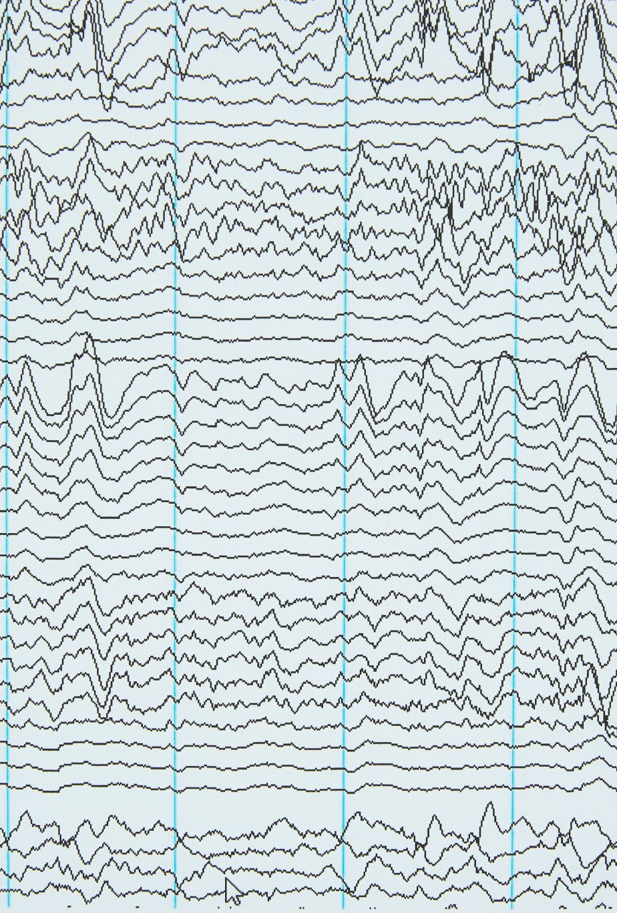
Experiment Tracking with Weights & Biases
Key Features Tracked:
Dataset Metadata: Documented dataset name, number of features, and train/test sizes.
Input Sequences: Logged sample input sequences and target distributions for reference.
Hyperparameters: Recorded values including Learning Rate, Hidden Size, Dropout Rate, Batch Size, and Number of LSTM Layers.
Metrics: Monitored per-epoch performance metrics such as Validation MSE, MAE, and R² score, along with training loss.
Final Evaluations: Evaluated and saved metrics on the test set for comparative analysis.
Model Artifacts: Saved the weights of the best-performing model for future analysis and reproducibility.
Notes:
Script:
To ensure systematic and reproducible experimentation, we used Weights & Biases (W&B) to track, monitor, and compare our model runs throughout the project.
Key Features Tracked:
Dataset Metadata:
We documented essential details such as the dataset name, the number of features, and the sizes of the train and test sets. This provided clear reference points for each experiment.
Input Sequences:
We logged sample input sequences and their corresponding target distributions, allowing us to visually inspect the data being fed into the model during training.
Hyperparameters:
We recorded key hyperparameters, including Learning Rate, Hidden Size, Dropout Rate, Batch Size, and the Number of LSTM Layers. This enabled us to identify which configurations led to optimal performance.
Metrics:
During each run, we monitored per-epoch performance metrics, such as Validation MSE, MAE, and R² score, along with training loss. This helped us track the model’s learning progress and detect overfitting or underfitting trends.
Final Evaluations:
For each run, we saved the final evaluation metrics on the test set, making it easy to compare model performance across different configurations.
Model Artifacts:
We saved the weights of the best-performing model as artifacts. This ensured we could reproduce the top model later and use it for further analysis or deployment.
By leveraging Weights & Biases, we maintained a detailed and organized record of our experiments, making it easy to identify the most effective model configurations and ensure reproducibility.

Slide 5

Modeling Approach and Experimental Setup
Model Choice: Utilized Long Short-Term Memory (LSTM) architecture to effectively capture temporal dependencies in the multivariate time series data.
Input Structure: Each model input consisted of 12 time steps (1 hour of past data) to predict the next value of Global Active Power.
Implementation Framework: Developed the LSTM model using PyTorch, leveraging Weights & Biases (W&B) for hyperparameter optimization and performance tracking.
Hyperparameter Tuning: Conducted sweeps on critical hyperparameters including Learning Rate, Hidden Size, Dropout Rate, Batch Size, and Number of Layers.
Each model was trained for 10 epochs, with Bayesian Optimization used to minimize Mean Squared Error (MSE) on the validation set.
Notes:
Script:
Modeling Approach:
Model Choice:
We selected the LSTM architecture due to its ability to learn long-range dependencies and patterns, making it ideal for sequential forecasting tasks.
Input Structure:
Each model input consisted of 12 time steps—equivalent to 1 hour of past data—which the model used to predict the next value of Global Active Power.
Implementation Framework:
We developed the LSTM model using PyTorch and integrated Weights & Biases (W&B) for streamlined hyperparameter optimization and performance tracking.
Experimental Setup:
Hyperparameter Tuning:
We conducted sweeps on key hyperparameters, including Learning Rate, Hidden Size, Dropout Rate, Batch Size, and the Number of LSTM Layers. This allowed us to identify the best-performing configurations.
Training Strategy:
Each model was trained for 10 epochs, with Bayesian Optimization used to minimize the Mean Squared Error (MSE) on the validation set, ensuring efficient and effective tuning.
By applying this modeling and experimental setup, we were able to systematically optimize our LSTM model and achieve high predictive accuracy for time series forecasting.

Slide 6
Hyperparameter Tuning Strategy
Hyperparameter | Range of values explored
Learning Rate | 0.0005, 0.001, 0.005, 0.01, 0.05
Hidden Size | 32, 64, 128
Dropout Rate | 0.1, 0.2, 0.3, 0.4, 0.5, 0.6
Batch Size | 16, 32, 64
Number Of Layers | 1, 2, 3
Notes:
Script:
To optimize our LSTM model, we applied a structured hyperparameter tuning strategy using Weights & Biases (W&B) sweeps with Bayesian Optimization.
Tuning Strategy:
Consistency in Training:
We used Bayesian Optimization in our W&B sweeps to minimize the Mean Squared Error (MSE) on the validation set, enabling efficient exploration of the hyperparameter space.
Hyperparameters and Ranges:
We tuned the following key hyperparameters across three team members:
Learning Rate: Ranged from 0.0005 to 0.05, covering both low and high values to balance convergence speed and stability.
Hidden Size: Explored values of 32, 64, and 128, allowing us to test different model capacities.
Dropout Rate: Ranged from 0.1 to 0.6, helping us evaluate the effect of regularization on model performance.
Batch Size: Tested sizes of 16, 32, and 64, balancing between gradient stability and training efficiency.
Number of Layers: Explored 1, 2, and 3 LSTM layers, capturing varying levels of complexity in the temporal patterns.
Comparative Analysis:
Each sweep run trained the model with a unique combination of hyperparameters, allowing us to compare the effects of different configurations on model accuracy and generalization.
By systematically tuning these hyperparameters, we were able to identify the most effective configurations, significantly improving our model's predictive performance.

Slide 7
Model Results
Team Member | Best MSE | Best R² Score | Common Traits of Best Runs
Prince | 0.00103 | 0.8702 | hidden_size=64, dropout=0.5, learning_rate=0.005
Debjani | 0.0009579 | 0.8788 | hidden_size=16–32, dropout=0.2, learning_rate=0.005
Kathryn | 0.00139 | 0.8235 | Improved LSTM with Xavier initialization, gradient clipping, L2 regularization, and 15 epochs
Notes:
Script:
To evaluate our model’s performance, each team member ran 10 experiments using the same LSTM architecture and dataset, but with different hyperparameter configurations through W&B sweeps.
Team Performance Overview:
Prince's Results:
Prince achieved a best MSE of 0.00103 and an R² score of 0.8702, indicating strong predictive accuracy.
The most effective configuration included a hidden size of 64, a dropout rate of 0.5, and a learning rate of 0.005.
Debjani's Results:
Debjani obtained the lowest MSE of 0.0009579 and the highest R² score of 0.8788, making it the most accurate model.
The common traits of the best runs featured hidden sizes between 16 and 32, a dropout rate of 0.2, and a learning rate of 0.005.
Kathryn's Results:
Kathryn’s model had a best MSE of 0.00139 and an R² score of 0.8235, still demonstrating strong performance but slightly lower accuracy.
Kathryn applied an improved LSTM configuration with Xavier initialization, gradient clipping, L2 regularization, and extended the training to 15 epochs, enhancing stability and generalization.
Key Takeaway:
Overall, Debjani's model achieved the highest accuracy, while Prince's configuration also performed well with strong R² values. Kathryn's enhanced model incorporated advanced techniques, showing improved robustness and stability despite a slightly higher MSE.

Slide 8
Common Characteristics of Top-Performing Models
Learning rate of 0.005, which provided a sweet spot between convergence speed and stability.
Batch size of 64, offering a good balance between gradient stability and training efficiency.
2 to 3 LSTM layers, allowing models to learn hierarchical temporal dependencies.
Dropout values varied: 0.2 for Member 2 and 0.5 for Members 1 & 3, both effective in preventing overfitting in their respective setups.
Notes:
Script: Despite experimenting with different hyperparameter configurations, the top-performing models shared several key characteristics that contributed to their accuracy and stability.
Key Characteristics:
Optimal Learning Rate:
All the best models used a learning rate of 0.005, striking a balance between convergence speed and model stability. This rate allowed the models to learn efficiently without overshooting the optimal solution.
Batch Size of 64:
The top models consistently used a batch size of 64, which offered a good balance between gradient stability and training efficiency, leading to smoother and more reliable updates.
2 to 3 LSTM Layers:
The best-performing models incorporated 2 to 3 LSTM layers, enabling them to learn hierarchical temporal dependencies, effectively capturing complex patterns in the multivariate time series data.
Effective Dropout Rates:
Dropout values varied slightly but were effective in preventing overfitting:
Member 2 used a 0.2 dropout rate, which worked well in their setup.
Members 1 and 3 applied a 0.5 dropout rate, providing stronger regularization and improving generalization.
These shared characteristics highlight the importance of learning rate selection, batch size consistency, and appropriate dropout regularization in achieving high-performing time series forecasting models.

Slide 9
Best Model Selection
After conducting extensive W&B sweeps across multiple configurations, the best-performing model was selected based on its validation performance. The chosen model had the following configuration:
Hidden Size: 32
Dropout: 0.2
Learning Rate: 0.005
Batch Size: 64
Number of Layers: 2
This configuration yielded the lowest test MSE of 0.00096, a MAE of 0.01698, and a strong R² score of 0.87831, indicating high predictive accuracy and generalization capability.
Notes:
Script:
After conducting extensive Weights & Biases sweeps across multiple configurations, we identified the best-performing model based on its validation performance and overall accuracy.
Best Model Configuration:
Hidden Size:
The optimal model used a hidden size of 32, providing sufficient capacity to capture temporal dependencies without overfitting.
Dropout Rate:
A dropout rate of 0.2 was applied, effectively preventing overfitting while maintaining model stability.
Learning Rate:
The model achieved optimal convergence with a learning rate of 0.005, balancing fast learning with stability.
Batch Size:
A batch size of 64 offered a good balance between gradient stability and training efficiency.
Number of Layers:
The model featured 2 LSTM layers, enabling it to learn hierarchical temporal dependencies, improving its forecasting accuracy.
Model Performance:
This configuration yielded the lowest test MSE of 0.00096, indicating minimal prediction error.
It achieved a Mean Absolute Error (MAE) of 0.01698, highlighting precise predictions.
The R² score of 0.87831 demonstrated strong generalization capability and accurate representation of the data’s variability.
“Overall, this best-performing model exhibited high predictive accuracy, effectively capturing complex temporal patterns in the multivariate time series data.”

Slide 10
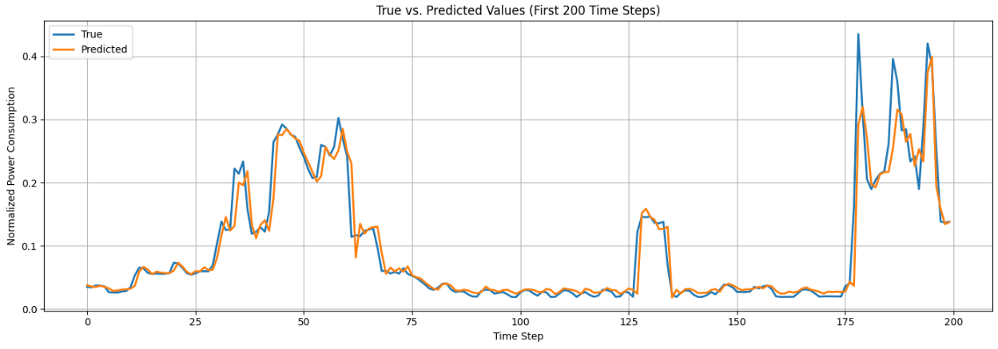
True vs. Predicted Line Plot (First 200 Time Steps)
Notes:
This line plot compares actual and predicted power consumption over the first 200 time steps. The predicted values closely follow the true values, particularly during sharp changes and peak consumption periods. This indicates that the model effectively captures both short-term variations and broader temporal trends.

Slide 11
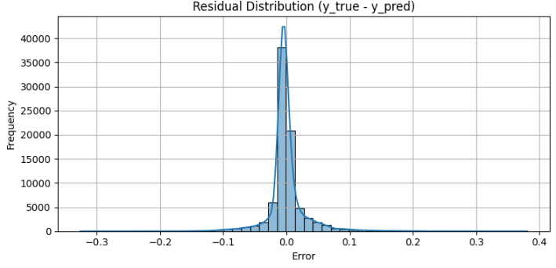
Residual Distribution Histogram
Notes:
The residuals (i.e., prediction errors) are tightly centered around zero with a narrow spread. This symmetric, bell-shaped distribution suggests that the model’s predictions are unbiased and consistent across time, with most errors being small.

Slide 12
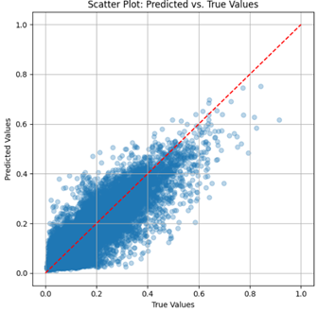
Scatter Plot: Predicted vs. True Values
Notes:
This plot visualizes the correlation between predicted and actual values. The dense clustering along the diagonal red line (representing perfect predictions) confirms the strong alignment between model output and ground truth. Some dispersion exists for higher values, but the model generally performs well across the range.

Slide 13
Conclusion
LSTM Model Development: Built an LSTM-based forecasting model to predict household power consumption using multivariate time series data.
Hyperparameter Experimentation: Conducted multiple experiments with Weights & Biases, testing various configurations to optimize performance.
Strong Model Performance: Best model achieved an MSE of 0.00096 and R² score of 0.878, indicating high predictive accuracy.
Effective Trend Capture: Visual evaluations confirmed the model effectively captured consumption patterns and trends.
Key Takeaway: Emphasized the importance of thorough preprocessing, systematic experimentation, and robust evaluation for reliable time series forecasting.
Notes:
Script:
In this project, we successfully developed and implemented a multivariate time series forecasting model using LSTM to predict household power consumption.
Key Takeaways:
Objective:
Our primary goal was to build an LSTM-based model capable of accurately forecasting future power consumption using historical multivariate time series data.
Data Preparation:
We applied thorough preprocessing techniques to transform the raw dataset into suitable sequential input-output pairs, ensuring the model received clean and properly formatted data.
Hyperparameter Exploration:
Through extensive hyperparameter tuning with Weights & Biases, we identified the best-performing model configuration, significantly enhancing the model’s accuracy and generalization.
Performance Metrics:
Our final model achieved an MSE of 0.00096 and an R² score of 0.878, demonstrating strong forecasting accuracy and reliable generalization.
Model Evaluation:
Visual assessments, including line plots, residual histograms, and scatter plots, confirmed the model's ability to capture and predict consumption patterns effectively.
Key Insights:
The project highlighted the importance of data preprocessing, systematic experimentation, and robust evaluation in building accurate and reliable time series forecasting models.
Overall, this project demonstrated how deep learning techniques combined with rigorous experimentation can effectively capture complex temporal dependencies, delivering high-accuracy forecasts for real-world applications.

Slide 14
Thank you

